Slide 1
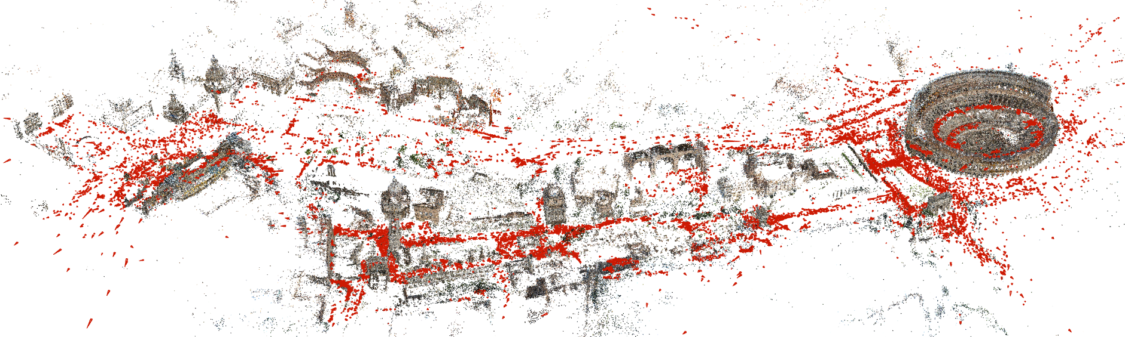
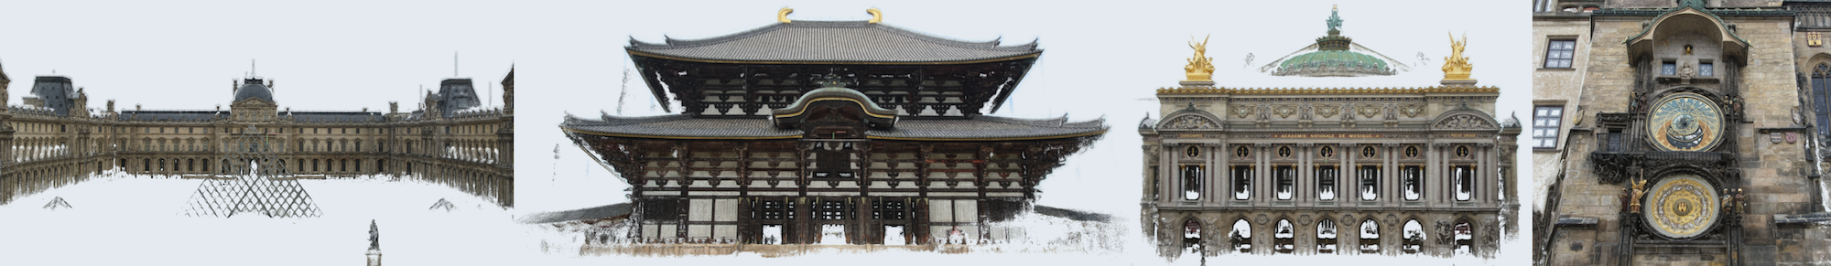
MAPTODON
MAPTODON
Masamune Ishihara Kotaro Suto Shun Kashiwa Dirk Wilson

Slide 2

Introducing…
MAPTODON
Decentralized 3D Scan Map and Sharing Platform

Slide 3
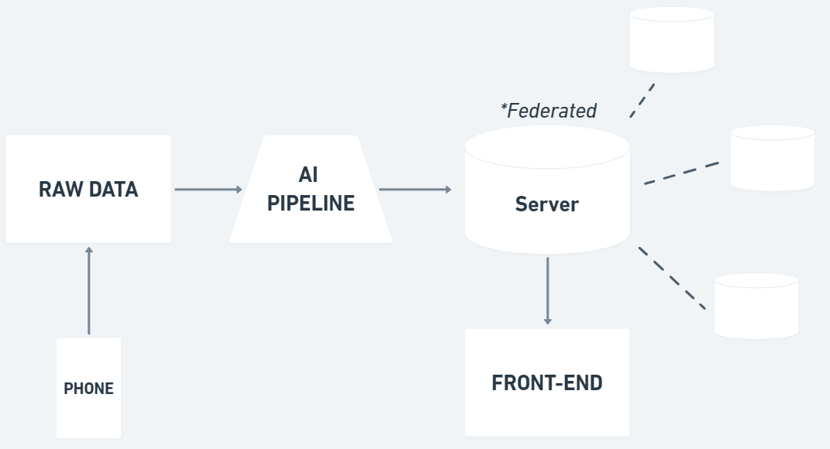
ARCHITECTURE
Notes:
Overview of MAPTODON system. We collect images from smartphones, using an AI pipeline to transform those 2D images into 3D scenes, viewable on the web.
3 Components, pass of to engineers of each respective stage.

Slide 4
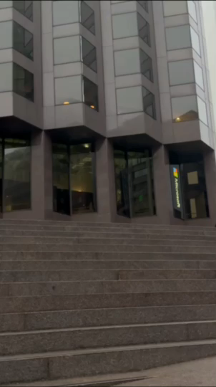
DATA COLLECTION
Notes:
Users capture images of surrounding using our mobile app.
Following the on-screen instructions, users will capture their surroundings via 2D images, sending the raw data to the AI pipeline.

Slide 5
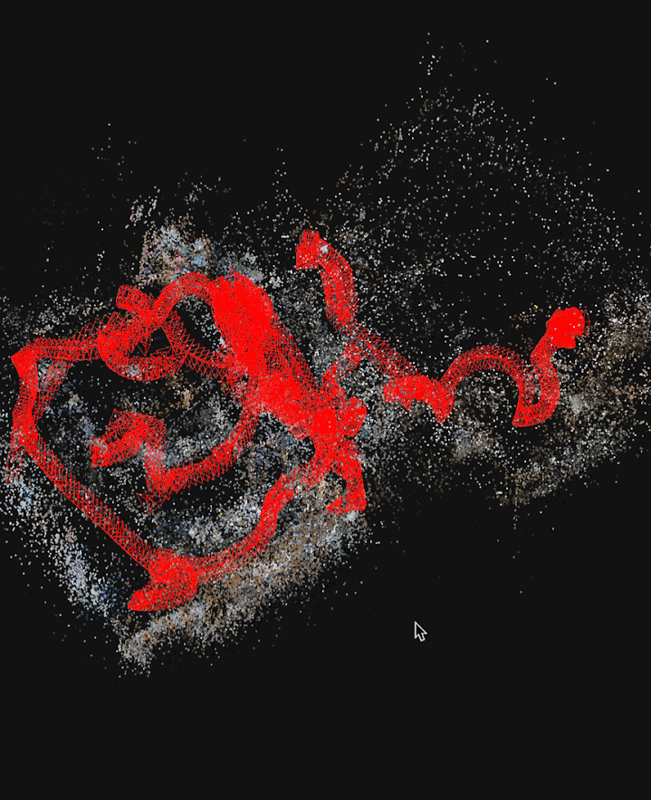
DATA PROCESSING
Notes:
Given a series of images, use hloc to get point cloud data and generate 3d view by using 3d gaussian splatting.

Slide 6
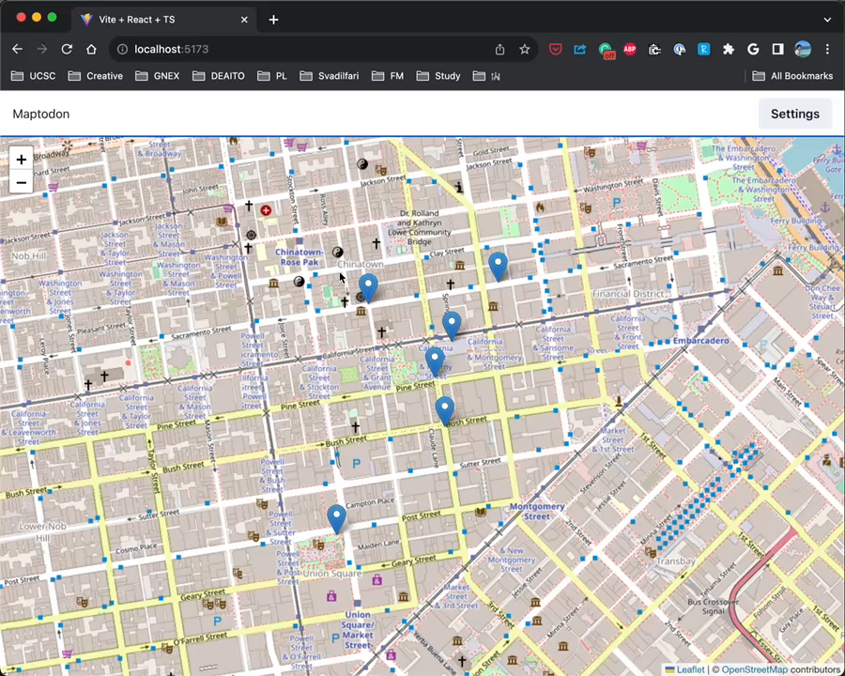
DATA PUBLISHING
3D Environments
Notes:
The client receives 3D environment data from federated servers, associating each scene with its coordinates. Clicking on a pin will render that coordinate’s associated environmental scan using webGPU.

Slide 7
KEY ADVANTAGES
Decentralized Servers
3D Environments
Notes:
The two key advantages unique to Maptodon are Decentralized Servers and 3D Environments. We are going to illustrate these advantages with two stories.

Slide 8
KEY ADVANTAGES
Decentralized Servers
3D Environments
Notes:
The two key advantages unique to Maptodon are Decentralized Servers and 3D Environments. We are going to illustrate these advantages with two stories.

Slide 9

Name: Shelton Age: 25
Job: Delivery Driver
Loc: Mozambique, Africa
Notes:
This is Shelton. He's a delivery driver who lives in Mozambique, Africa. However, after moving to a new city, he is unfamiliar with the layout.

Slide 10
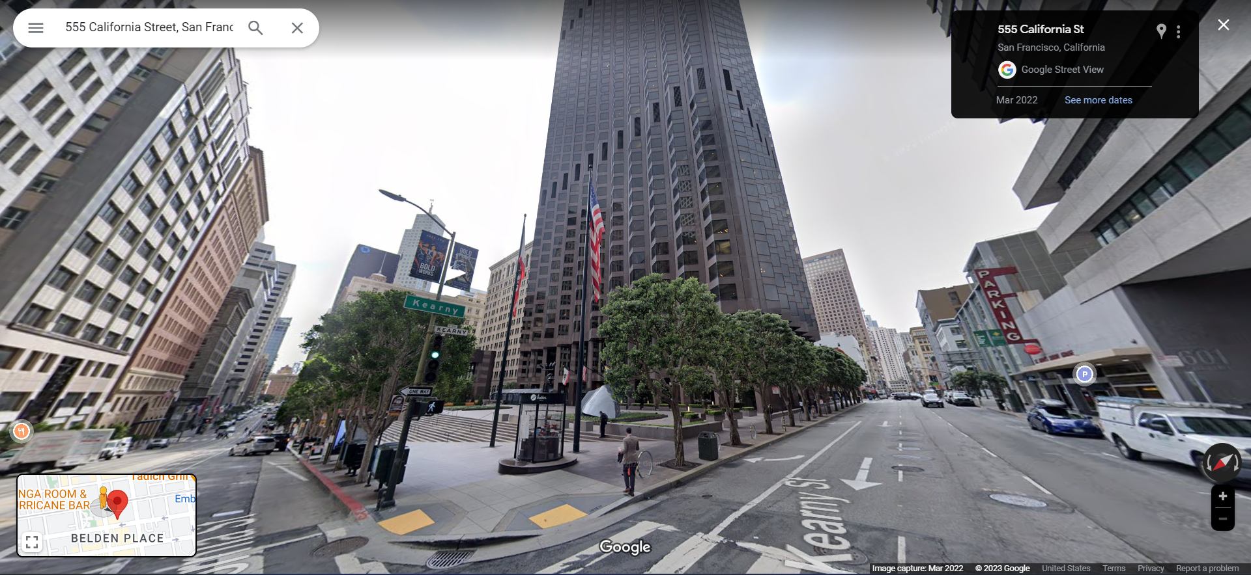
Notes:
Usually, when we want to figure out where we are headed, we use Google SV to get a better sense of the exact destination. If fact, this is what I was looking just before we got here.

Slide 11

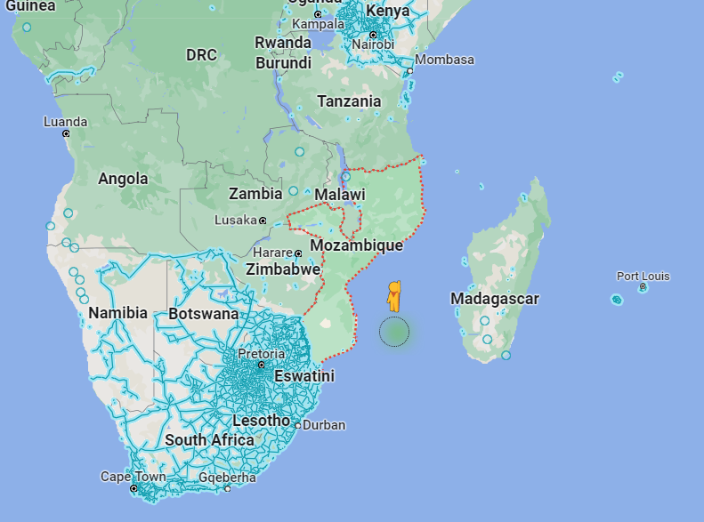
Notes:
HOWEVER, that’s not an option for our man Shelton because there’s no Google SV support in Mozambique.

Slide 12



Host
Government
Maptodon
Browse Data
Upload Data
Local Residents
Shelton
Notes:
Luckily for Shelton, his government set up a local instance of MAPTODON, which allows local residents of Mozambique to use their own smartphones to create environmental scans. This now allows Shelton to easily spot the exact location he is meant to drop off packages.

Slide 13
KEY ADVANTAGES
Decentralized Servers
3D Environments
Notes:
But MAPTODON isn’t just a SV clone. MAPTODON provides a novel way of viewing the environment in 3D. One such use-case of its 3D capabilities has to do with disaster relief.

Slide 14
KEY ADVANTAGES
Decentralized Servers
3D Environments

Slide 15
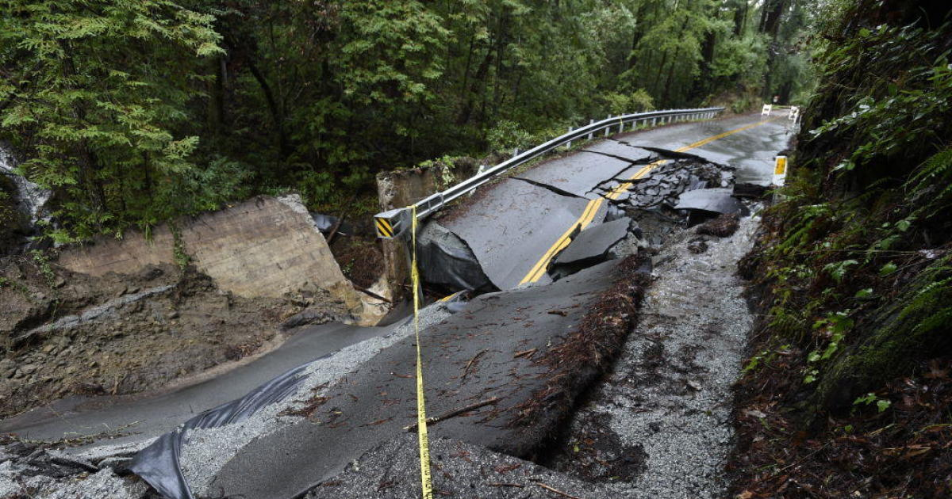

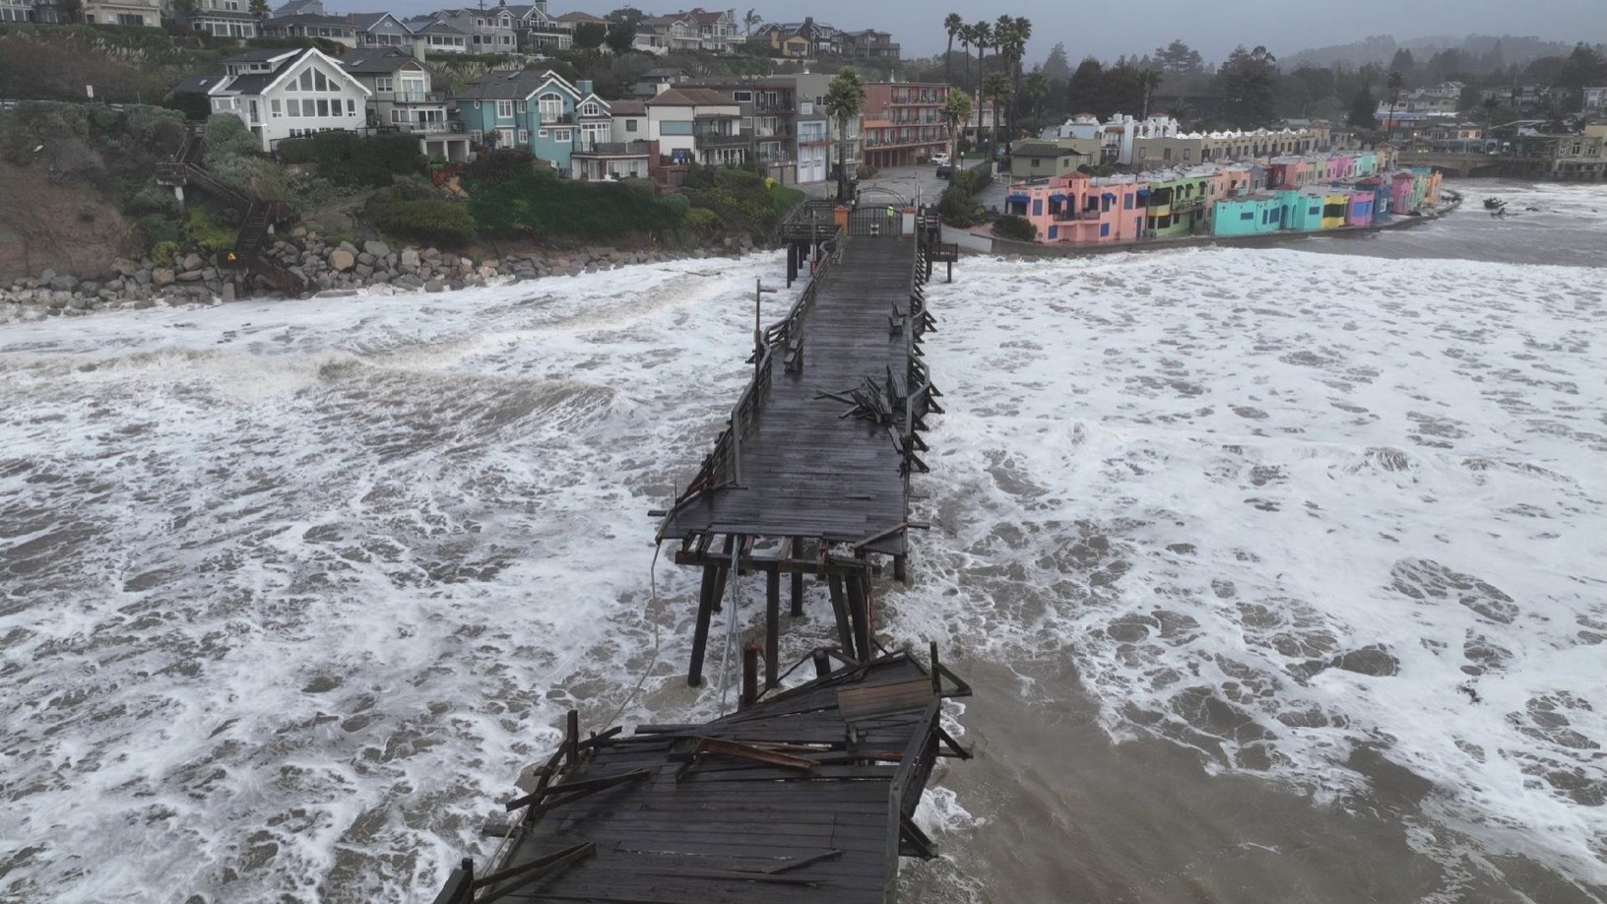
Storms 2023 in Santa Cruz
Notes:
We are students from UC Santa Cruz. Last Winter, we got hit by a severe storm that cause floods and multiple land slides.

Slide 16
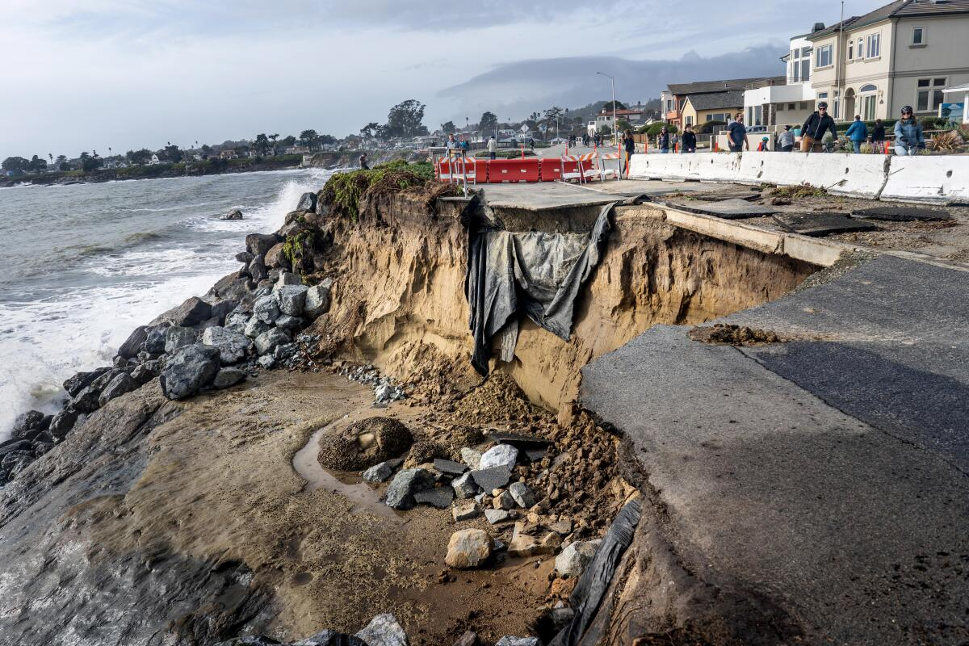
And more…
Notes:
This is a picture of West Cliff St. As you can see, the storm caused quite a bit of damage to our roads.
The 3D capability of MAPTADON will enable civil engineers a clearer picture of the situation that they’re dealing with, allowing better logistical decisions to be made while delivering a clearer image of their plan to locals.

Slide 17
And more…
Historical Preservation
Immersive Education
Virtual Tourism
3D Environments
MAPTODON
Decentralized 3D Scan Map and Sharing Platform
AI model creates 3D environments from 2D images
Potential applications in navigation, disaster relief, and many more.
Notes:
The two examples we showed today are just two of many possible applications of MAPTODON.

Slide 18
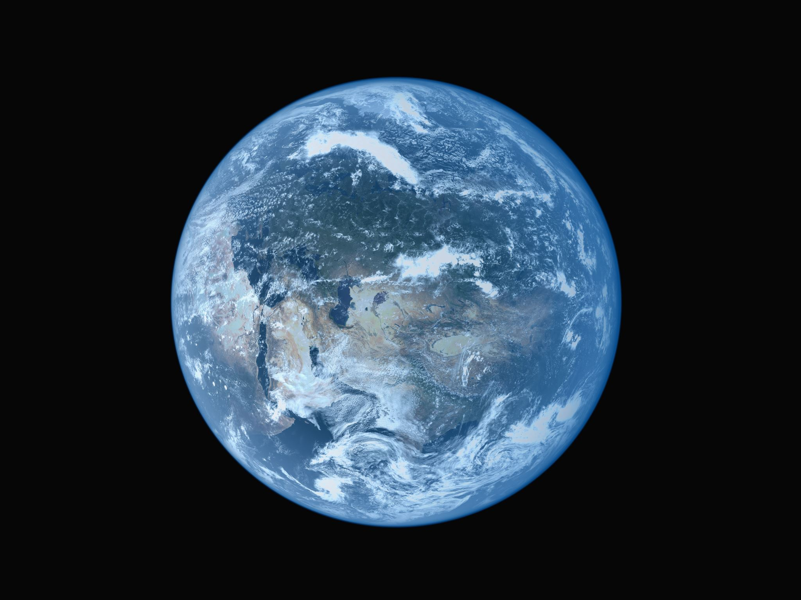
MAPTODON
Decentralized 3D Scan Map and Sharing Platform
AI model creates 3D environments from 2D images
Potential applications in navigation, disaster relief, and many more.
Notes:
So, to review, MAPTODON IS…

Slide 19
Historical Preservation
Archive 3D details of environments all over the globe
View past environments and structures even after events causing them to disappear
Preserving details of our world for future generations

Slide 20
More Immersive Education
Crowd-sourced scans to supplement learning in the classroom
Immersive exploration enhances understanding and retention
Culturally important sites more likely to have scans thanks to tourism

Slide 21
Monitoring Ecosystems
Monitoring effects of climate change on ecosystems
Visual representation of an ecosystem’s change overtime
Public engagement: Remotely explore ecosystems
Increased appreciation and funding for preservation efforts

Slide 22
Notes
Emphasis on 3D aspect and anyone can contribute
Create a story with this
Covering areas that are not covered
Disaster relief
“There are areas in the world not covered by Google SV” TRUCK DRIVER, WEAK BRIDGE, CAN DO IN US CUZ STREET VIEW, BUT NOT AFRICA. Government put local instance of Maptodon, allowing residents to use basic cameras to create 3D scans. Focus on the fact that anyone can do this one. (Shelton, Mozambique, Africa) Travelling around Africa, delivering [something] to villages in Mozambique. Just started delivery driving. We often use street view to find the proper building to match the address beforehand. Luckily for Shelton, government to instance of Maptodon and utilizes community made scans that were made with usual smartphone. 1…2…3… HOWEVER
We’re not just a clone of Google SV, we also have 3D capabilities, which opens up new use cases. Then talk about better responding to natural disasters. We are students at Santa Cruz. We had a storm. But for Santa Cruz, focus more on the 3D aspect. More disasters global warming, huge storm hit last winter, even Joe came. Landslides occurred in the area and blocked major highways within the area. The government had to get first responders to recon the area. 911 call, caller descriptions not enough. Use Maptodon to get better sense of the situation. Helps with decisions in logistics to recover from the disaster.
AND MORE
Throw a bunch of ideas

